Slide 1

Quadrature Down Converter
Analog Electronic Circuits (EC2.103)

Slide 2
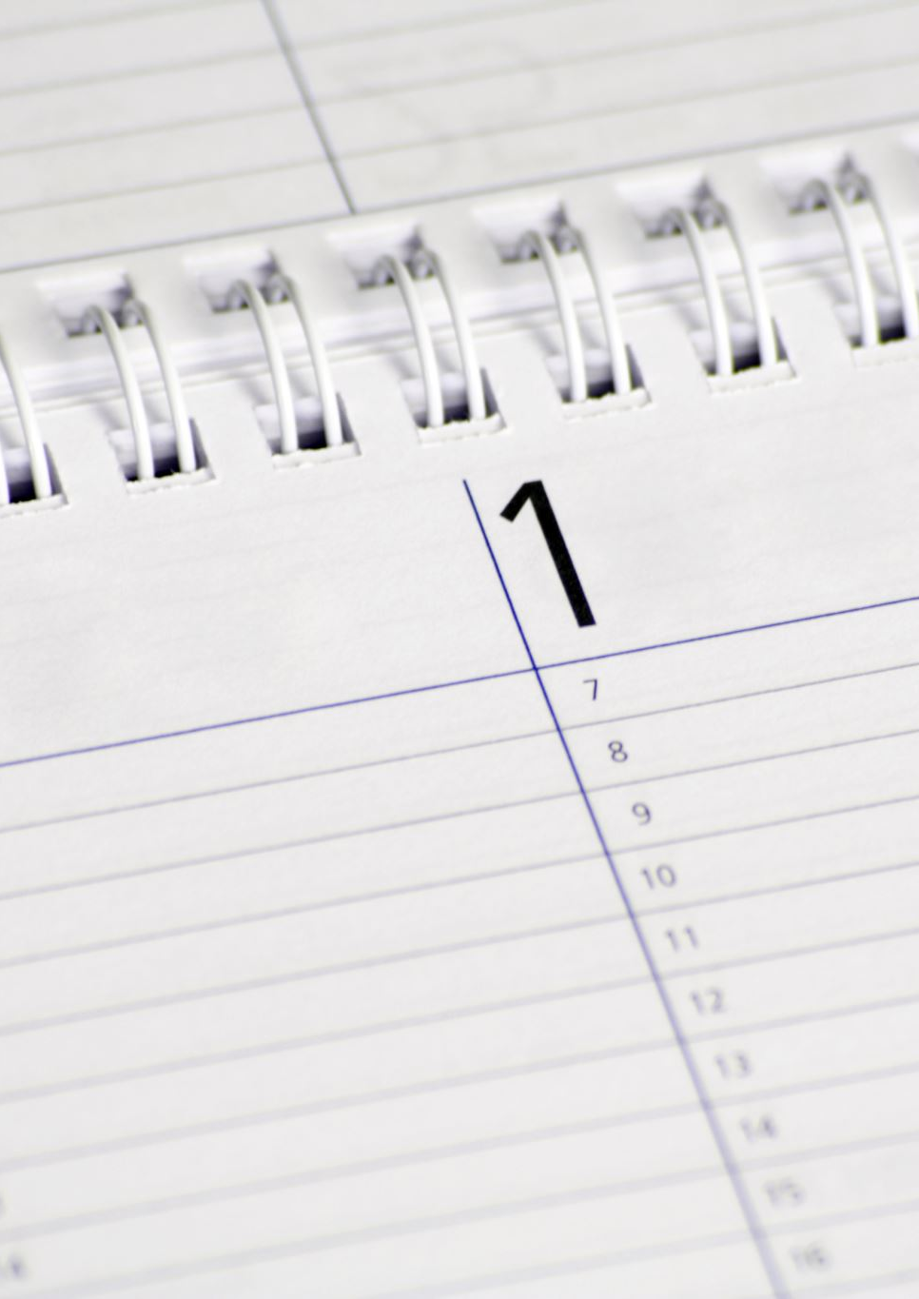
Team Members
Ravi Kumar Sahu
Nav Singhal (2024102004)
Anuj Kumar Tiwari (2024102021)

Slide 3
Project overview
Quadrature oscillator design
Switch (mixer) design
Low pass filter
Complete Circuit Integration

Slide 4

Switch (mixer) design
The objective is to demonstrate frequency mixing using an NMOS switch, where the gate receives a high-frequency oscillator signal and the source receives a low-frequency input signal, producing sum and difference frequency components (IF) at the drain.

Slide 5

Mixer design using NMOS (circuit & simulation setup)

Slide 6
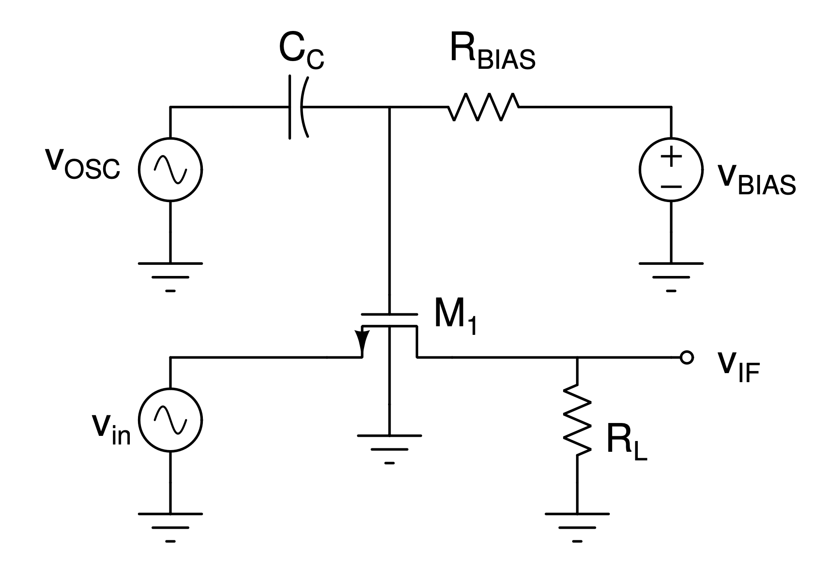
Mixer Reference Schematic

Slide 7

Mixer Design Considerations and Process
What we want our mixer to do is to reduce the frequency of our input wave without attenuating its signal so that it is easier for us to perform amplification and filtering.
We want the mixer to multiply the signals, because in the frequency domain, this results in convolution. So, when we take the Fourier transform of the output, we see frequency components at the sum and difference of the input RF signal and the Local Oscillator (LO) signal.
This is where the NMOS comes into play, we want a function where we can multiply both the RF input and the LO input(basically our cosine and sine generator). This comes to us in the form of the drain current equation for an NMOS in linear region.
Note that we specifically use the linear region here because in the linear region the MOSFET acts as a voltage controller resistor, it does not affect the signal much, however if we were to go into the saturation region, then we would see amplification and hence a distortion of the signal which is something that we don't want.

Slide 8
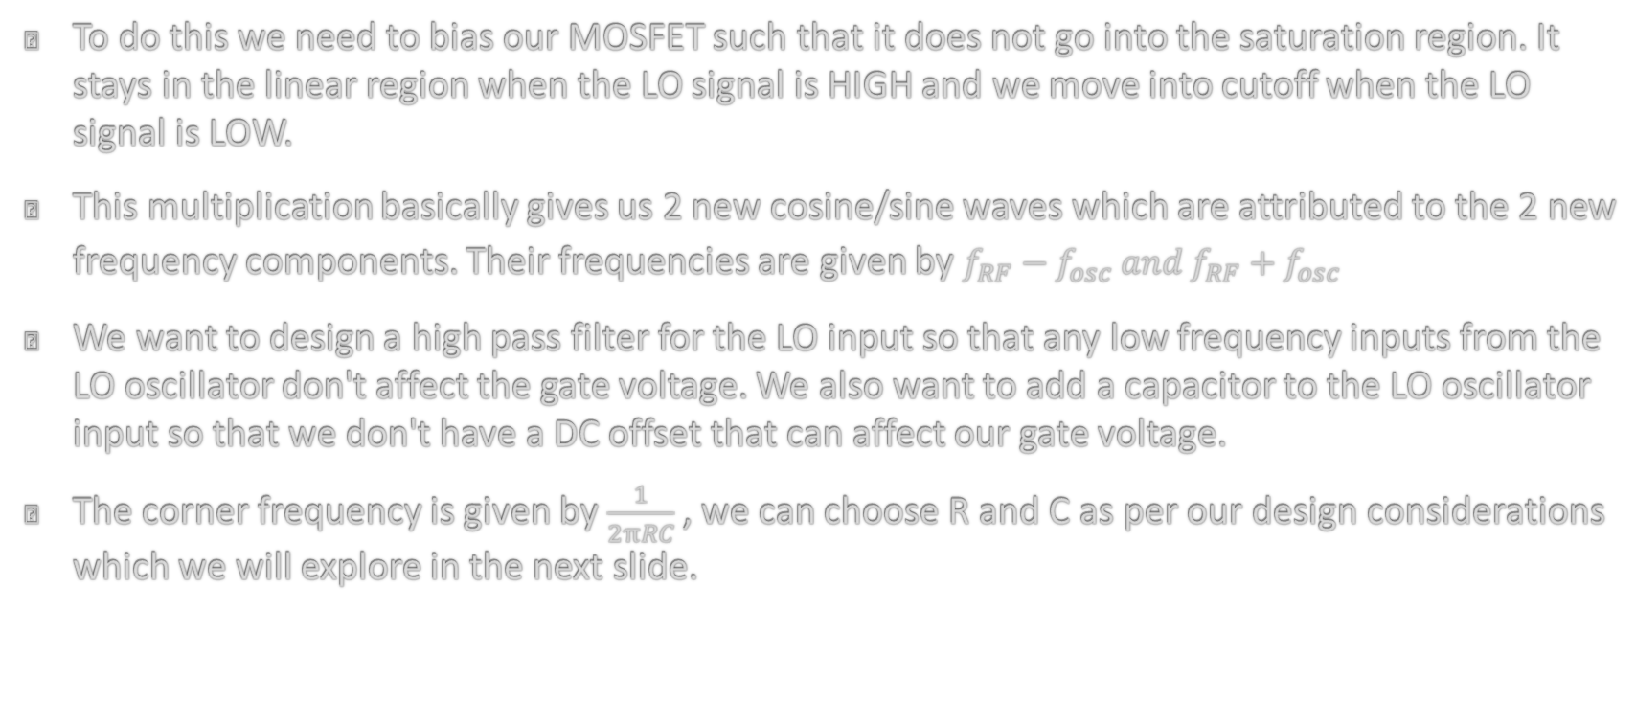
Mixer Design Considerations and Process
To do this we need to bias our MOSFET such that it does not go into the saturation region. It stays in the linear region when the LO signal is HIGH and we move into cutoff when the LO signal is LOW.
This multiplication basically gives us 2 new cosine/sine waves which are attributed to the 2 new frequency components. Their frequencies are given by $f_{RF}−f_{osc} and{ f}_{RF}+f_{osc}$
We want to design a high pass filter for the LO input so that any low frequency inputs from the LO oscillator don't affect the gate voltage. We also want to add a capacitor to the LO oscillator input so that we don't have a DC offset that can affect our gate voltage.
The corner frequency is given by $\frac{1}{2πRC}$ , we can choose R and C as per our design considerations which we will explore in the next slide.

Slide 9
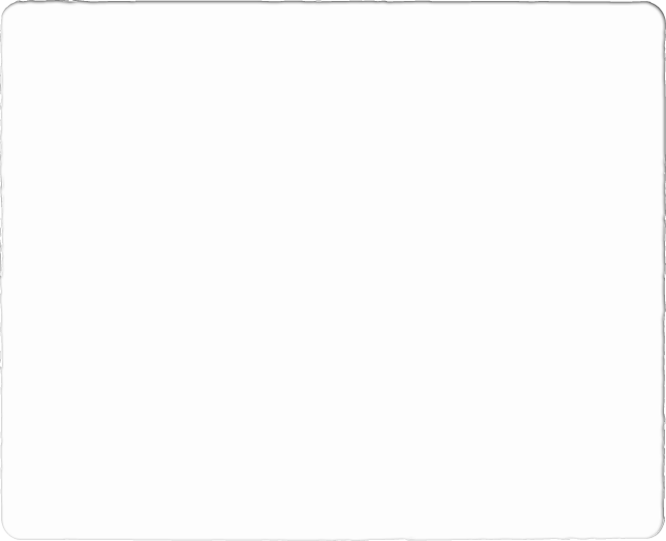
Mixer Design Considerations and Process
What we want out of our high pass filter is for our LO oscillator to pass through easily, we also want it to have a low time constant so as to prevent large loading times or settling times. We also want to make it so that it is relatively easy to manufacture and can easily block DC offset.
For this we chose to use a capacitor of value of 10 nF and a resistor of 100 k $Ω.$ This gives us a cutoff frequency of 1.59 kHz, which sufficiently blocks lower frequencies and allows our 100 kHz LO wave to pass through.
For this we chose to use a capacitor of value of 10 nF and a resistor of 100 k Ω. This gives us a cutoff frequency of 1.59 kHz, which sufficiently blocks lower frequencies and allows our 100 kHz LO wave to pass through.
It can also be observed that the time constant is 1 MS, which is small enough so that the signal can settle down quickly. Also note that these are very common values and can easily be found f$abricated$ while providing good DC offset blocking.
It can also be observed that the time constant is 1 MS, which is small enough so that the signal can settle down quickly. Also note that these are very common values and can easily be found fabricated while providing good DC offset blocking.
We also see that if we look from the$V_{\left\{BIAS\right\}}$ side, this conveniently acts as a low pass filter, so it also effectively blocks frequencies below 1.59 kHz which is good enough for our use case
We also see that if we look from the 𝑉_{𝐵𝐼𝐴𝑆} side, this conveniently acts as a low pass filter, so it also effectively blocks frequencies below 1.59 kHz which is good enough for our use case

Slide 10
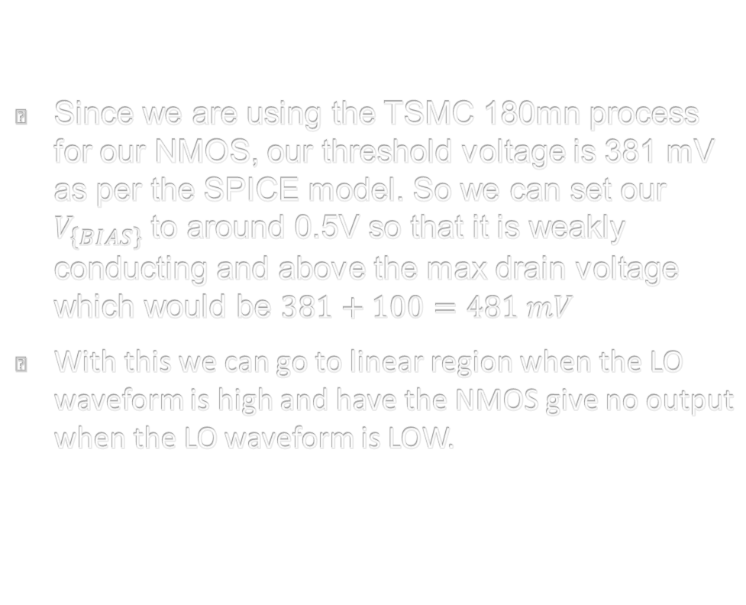
Mixer Design Considerations and Process
Since we are using the TSMC 180mn process for our NMOS, our threshold voltage is 381 mV as per the SPICE model. So we can set our $V_{\left\{BIAS\right\}}$ to around 0.5V so that it is weakly conducting and above the max drain voltage which would be $381+100=481 mV$
With this we can go to linear region when the LO waveform is high and have the NMOS give no output when the LO waveform is LOW.

Slide 11
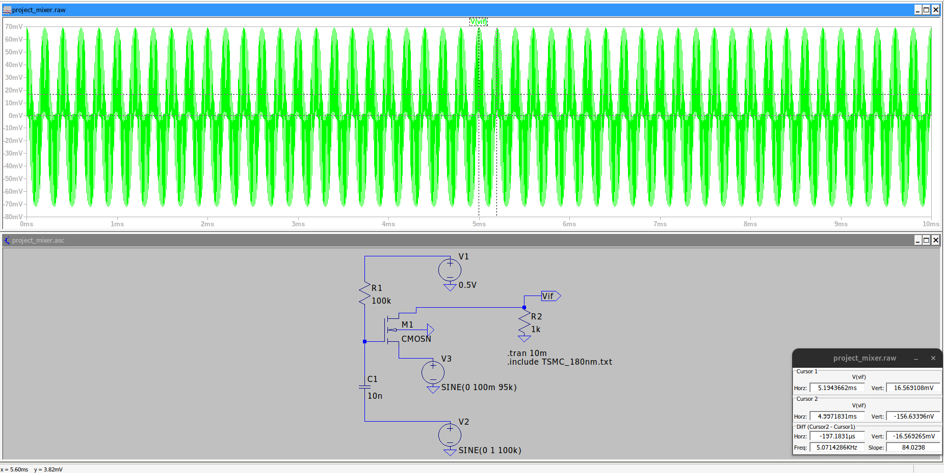
Mixer 95 kHz Tran Run

Slide 12
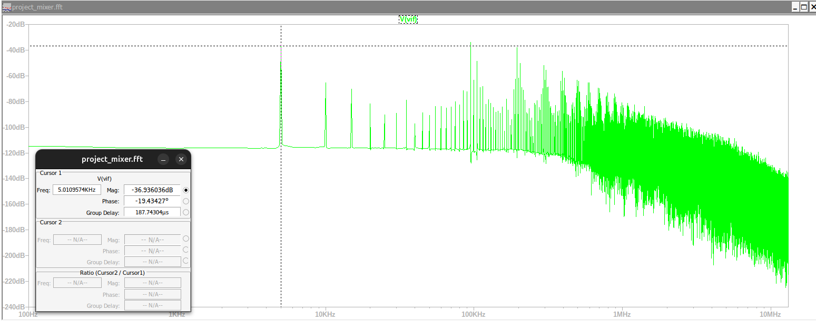
Mixer 95 kHz FFT

Slide 13
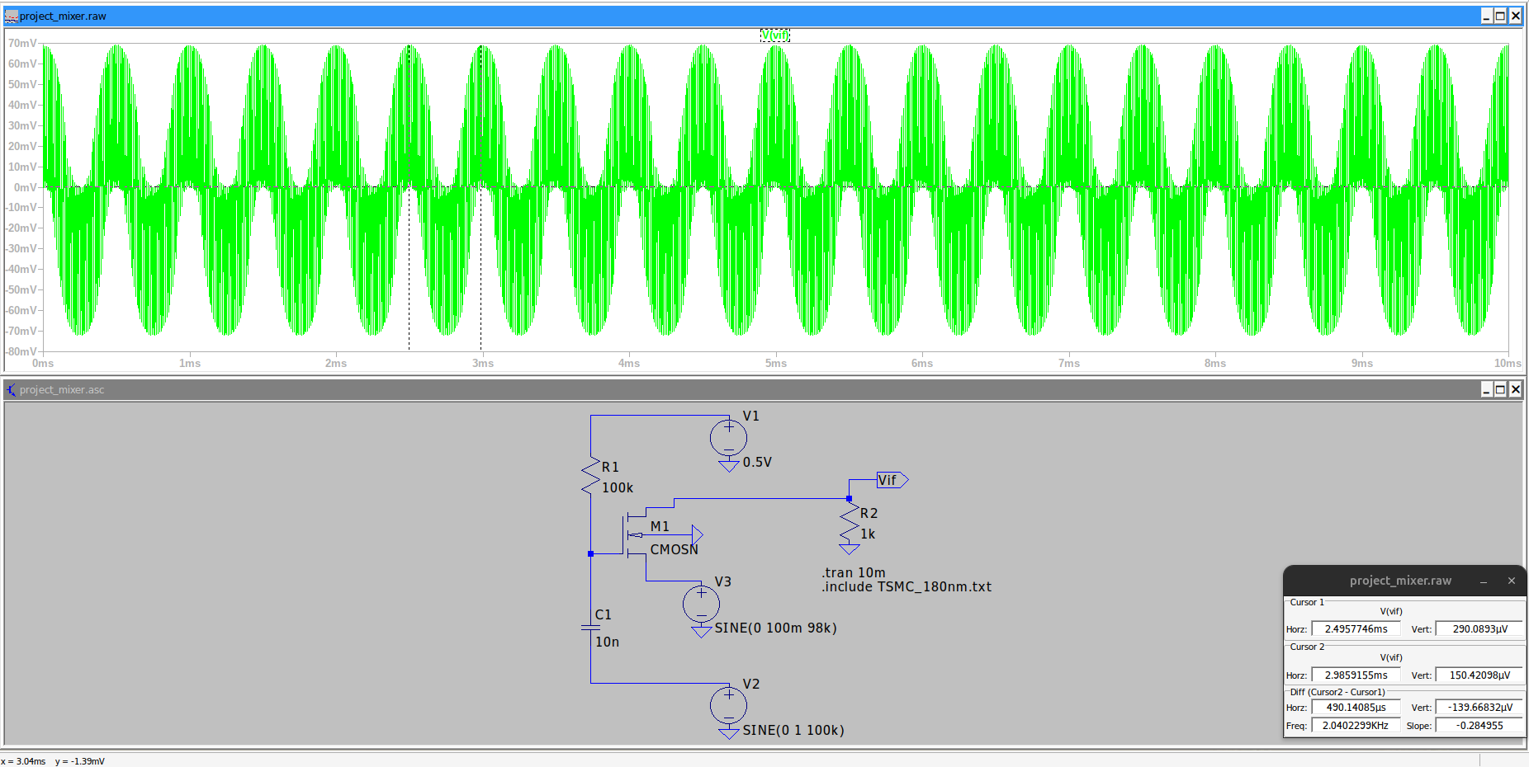
Mixer 97 kHz Tran Run

Slide 14
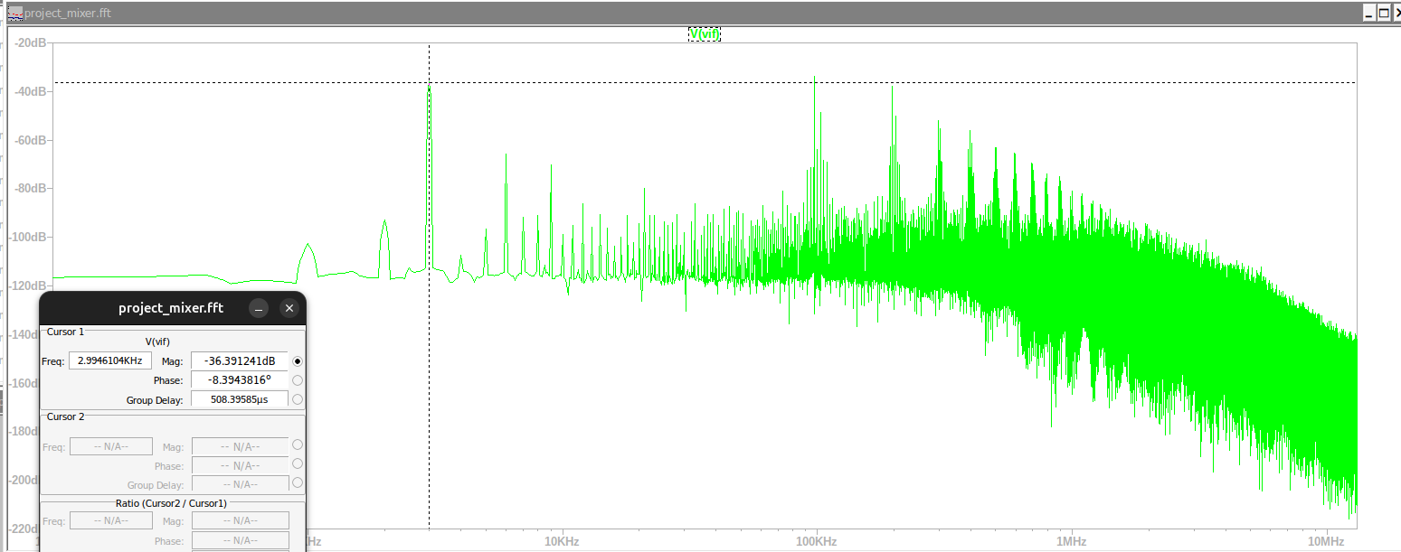
Mixer 97 kHz FFT

Slide 15
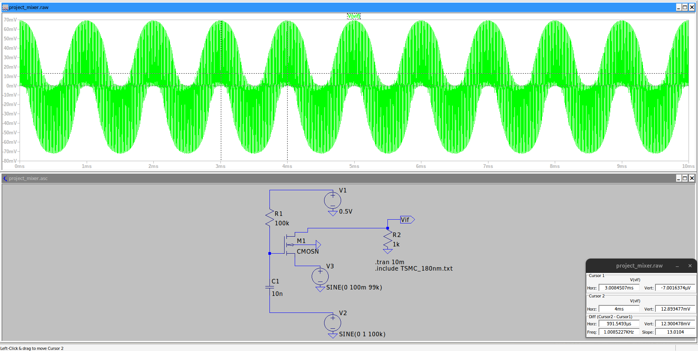
Mixer 99 kHz Tran Run

Slide 16
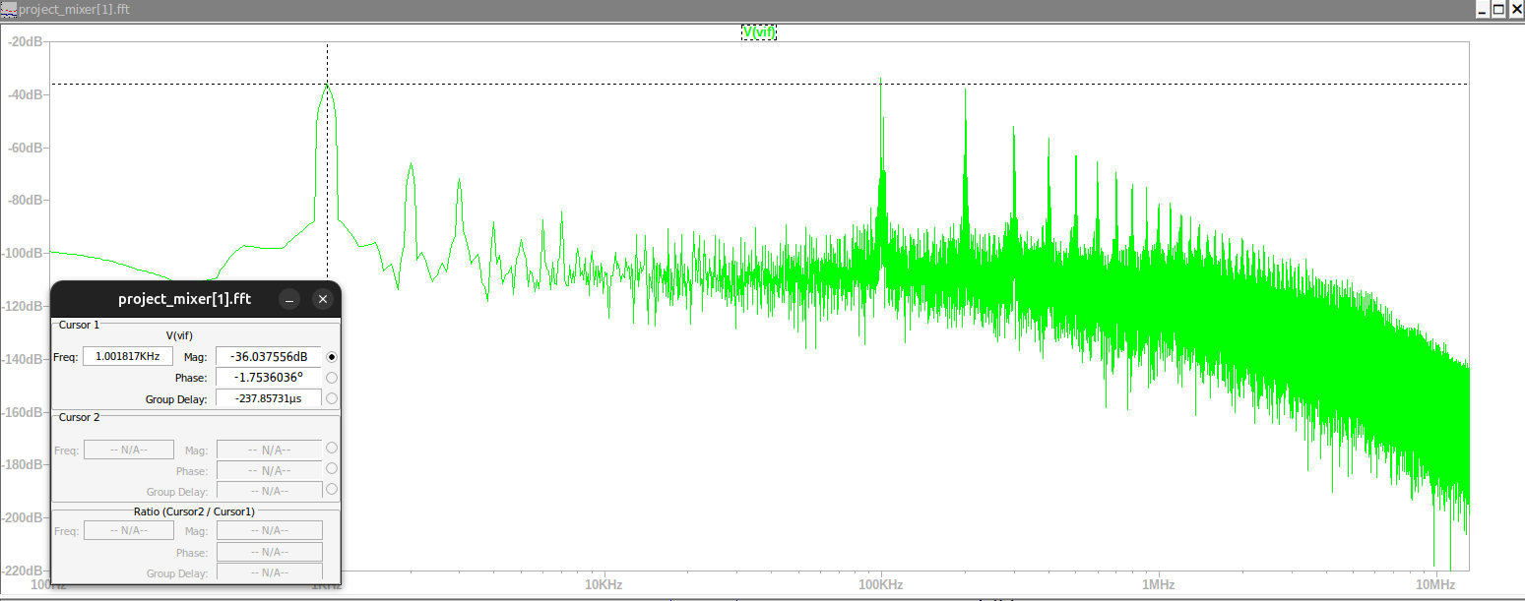
Mixer 99 kHz FFT

Slide 17
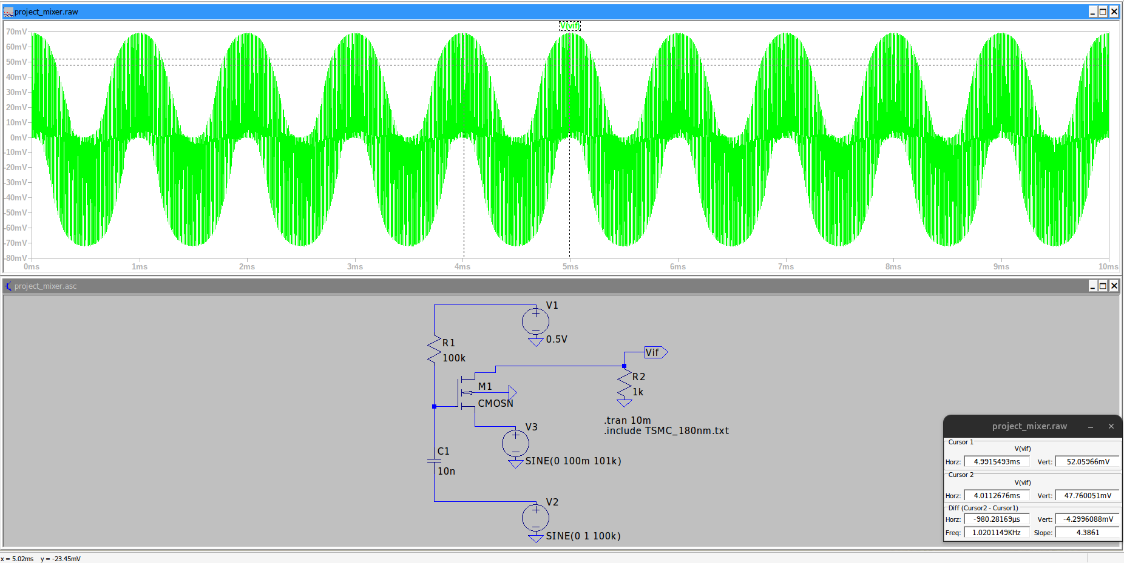
Mixer 101 kHz Tran Run

Slide 18
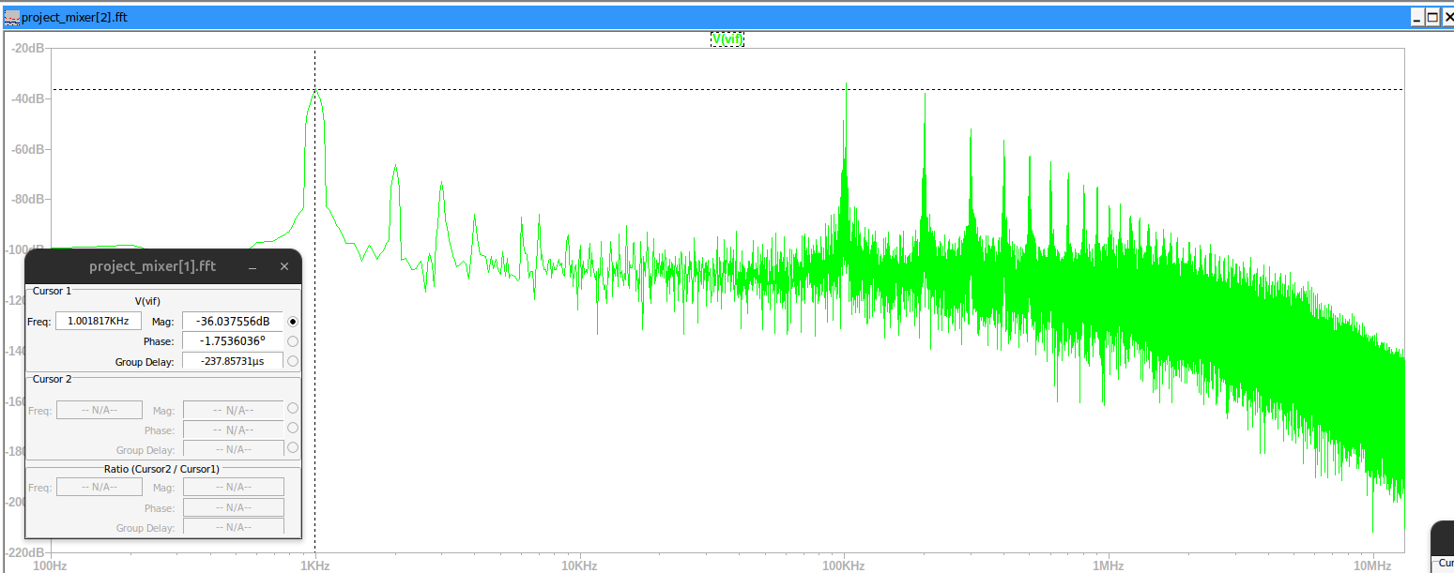
Mixer 101 kHz FFT

Slide 19
Mixer 101 kHz FFT

Slide 20

Mixer 102 kHz Tran Run

Slide 21
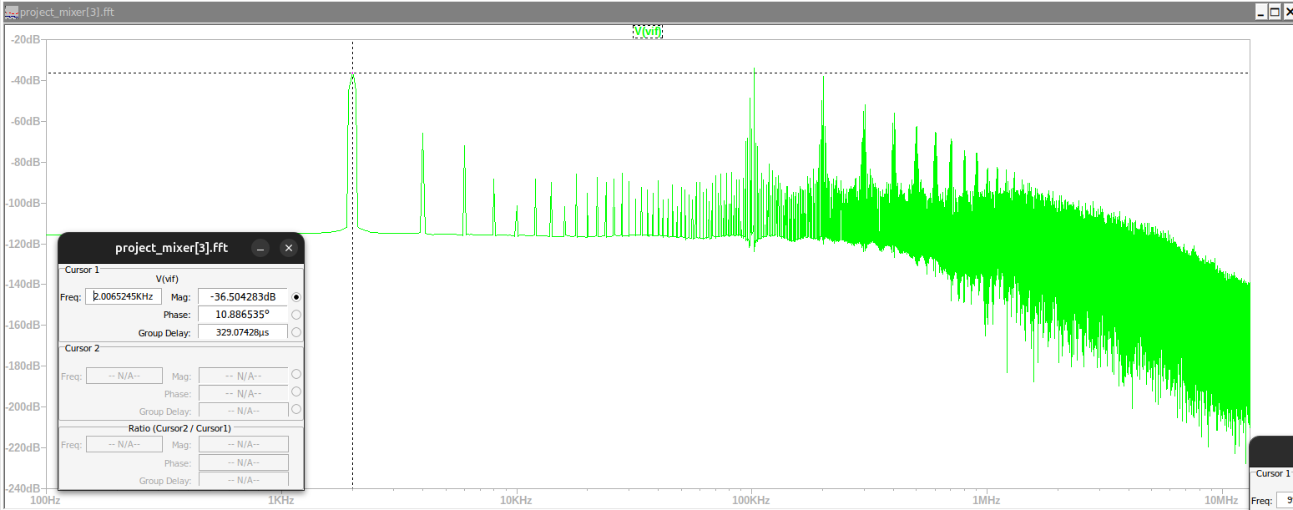
Mixer 102 kHz FFT

Slide 22
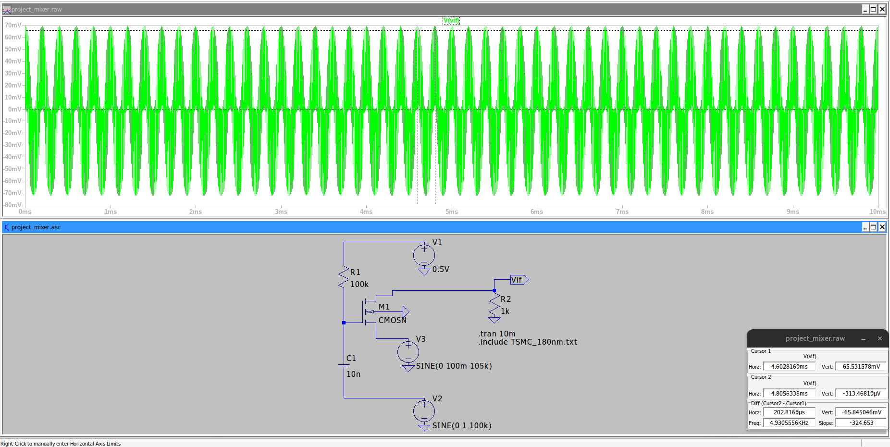
Mixer 105 kHz Tran Run

Slide 23
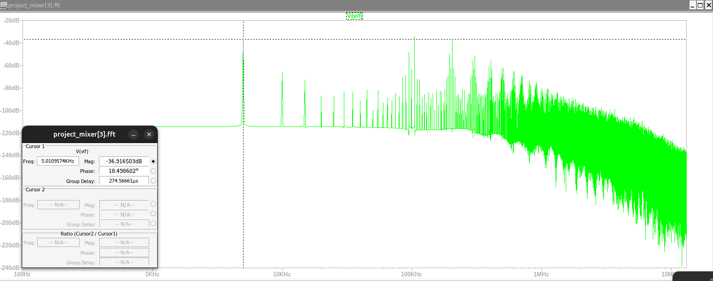
Mixer 105 kHz FFT

Slide 24
observation
Hence we can safely say that our mixer is working as designed and intended
From the FFT plots we can see that there is a new peak at the lower frequency end of the plot at the $\left|f_{\left\{RF\right\}}−f_{\left\{OSC\right\}}\right|$ frequency as well as the contribution of the $\left|f_{\left\{RF\right\}}+f_{\left\{OSC\right\}}\right|$frequency has increased as can be seen from the FFT plot.
From the FFT plots we can see that there is a new peak at the lower frequency end of the plot at the |𝑓_{𝑅𝐹} −𝑓_{𝑂𝑆𝐶} | frequency as well as the contribution of the |𝑓_{𝑅𝐹} +𝑓_{𝑂𝑆𝐶} | frequency has increased as can be seen from the FFT plot.
We can see from the transient run that the overall sine wave that we get is of a lower frequency, that is, the absolute value of the difference in the LO frequency and the RF frequency

Slide 25

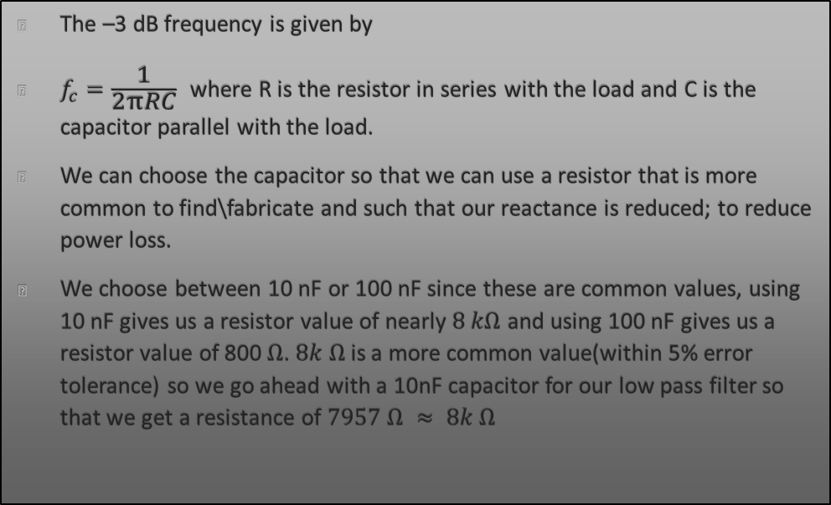
Low Pass Filter
The –3 dB frequency is given by
$f_{c}=\frac{1}{2πRC}$ where R is the resistor in series with the load and C is the capacitor parallel with the load.
We can choose the capacitor so that we can use a resistor that is more common to find\fabricate and such that our reactance is reduced; to reduce power loss.
We choose between 10 nF or 100 nF since these are common values, using 10 nF gives us a resistor value of nearly $8 kΩ$ and using 100 nF gives us a resistor value of 800 $Ω$. $8k Ω$ is a more common value(within 5% error tolerance) so we go ahead with a 10nF capacitor for our low pass filter so that we get a resistance of $7957 Ω ≈ 8k Ω$

Slide 26
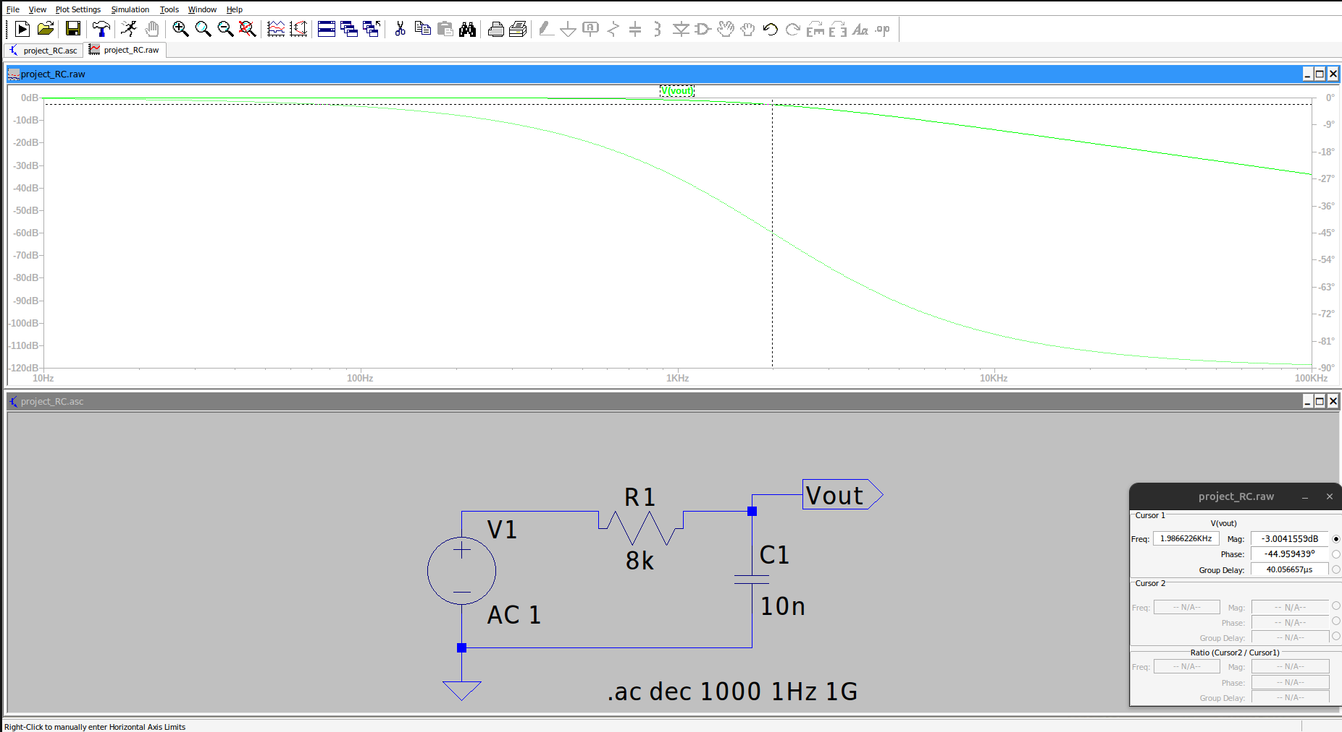
RC Low Pass Frequency Analysis

Slide 27

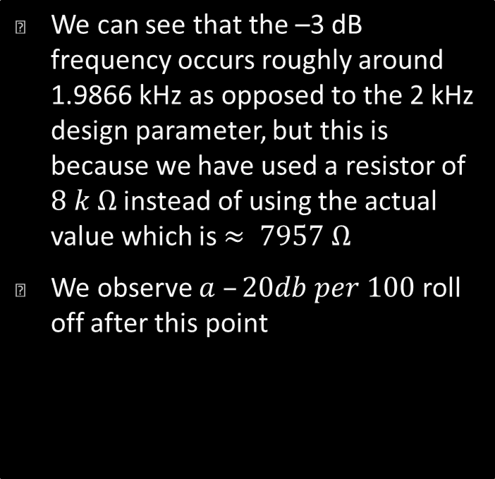
Observations for Frequency Analysis
We can see that the –3 dB frequency occurs roughly around 1.9866 kHz as opposed to the 2 kHz design parameter, but this is because we have used a resistor of $8 k Ω$ instead of using the actual value which is $≈ 7957 Ω$
We observe $a –20db per 100$ roll off after this point

Slide 28
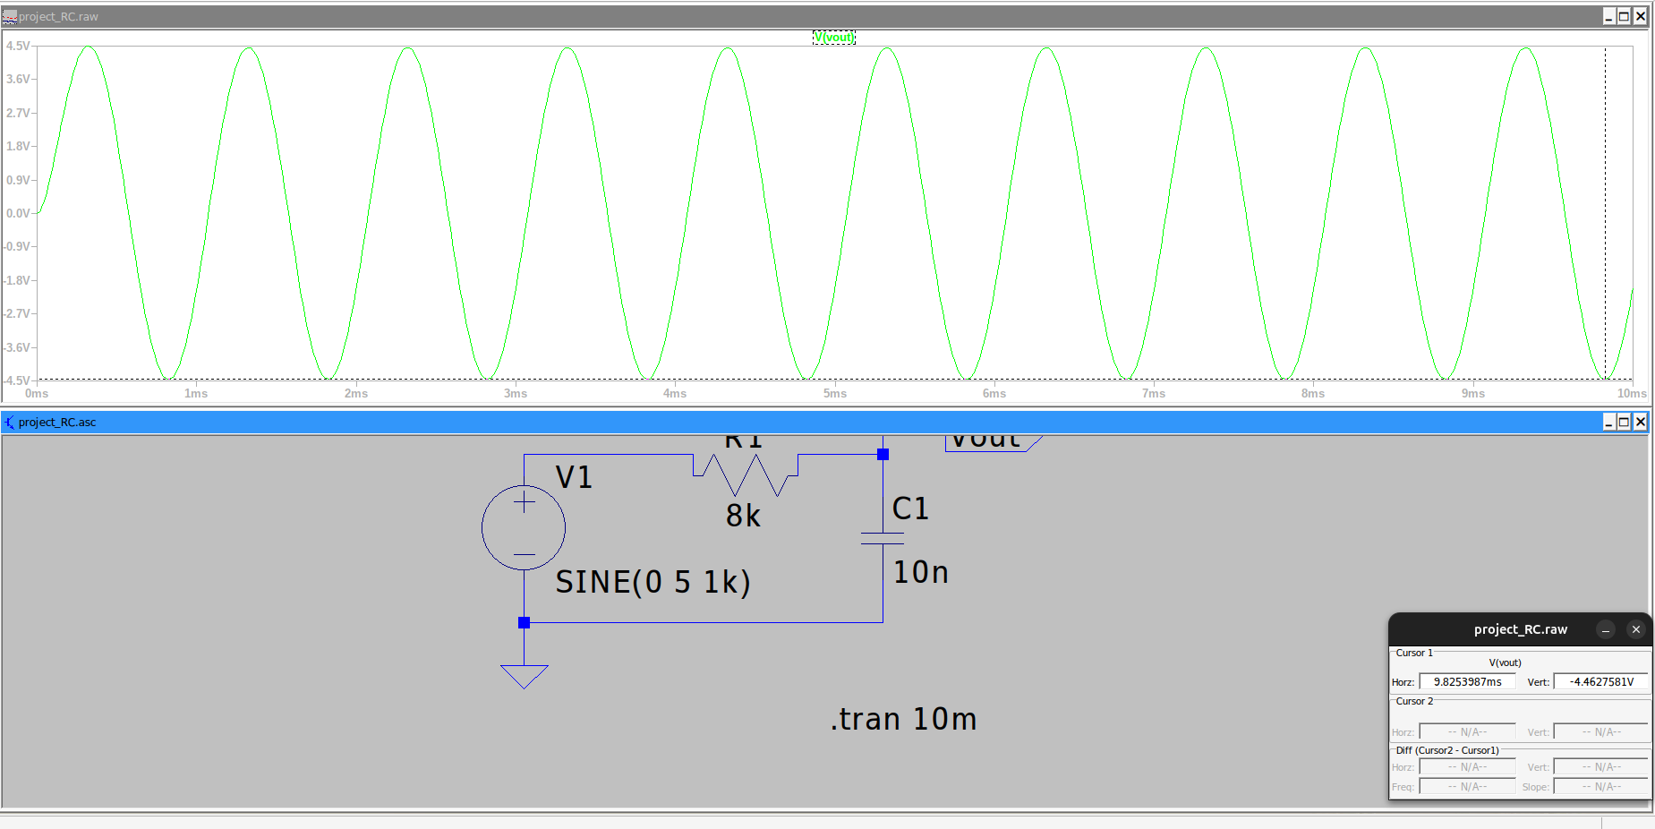
Tran Run 1kHz LTSPICE

Slide 29
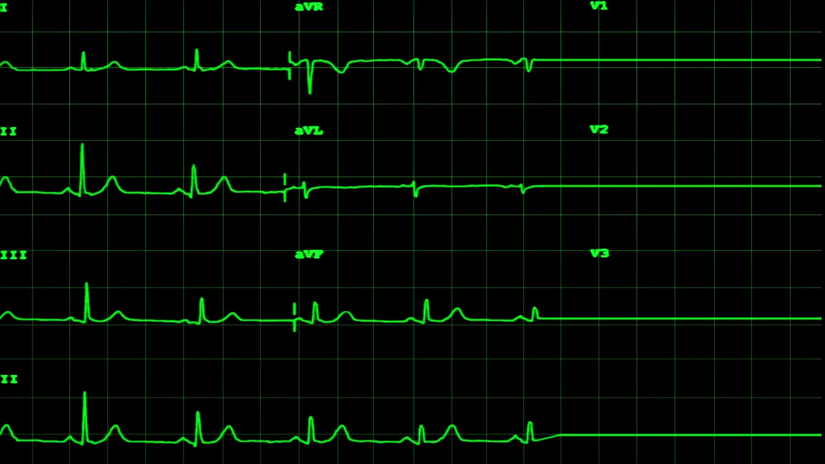
Observations of Tran Run 1kHz
We see that the voltage output for a 10Vpp sine wave input is 9Vpp

Slide 30
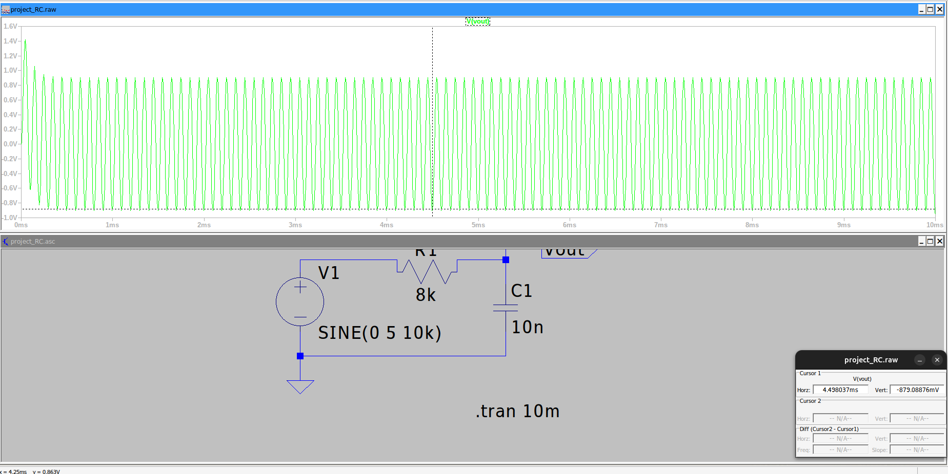
Tran Run 10Khz LTSPICE

Slide 31
Observations of Tran Run 10kHz
We see that for an input sine wave with amplitude 10Vpp and frequency 10kHz, the output wave has an output of roughly 1.9-2Vpp.
This shows that for higher frequencies, there is very high attenuation of the input signal

